Slide 1


Online Complaint Registration and Management System
By:
Sachin Anandharaj - 310821104081
Tharun KP - 310821104100
Praveen Raja M.P - 310821104070
Navin Raj. K - 310821104064

Slide 2
Introduction
Complaint Management System - Simplifying User Experience
Objective: The aim is to create a streamlined complaint management system that automates the process, enhances user experience, and improves issue resolution efficiency.
Tech Stack: MERN (MongoDB, Express.js, React.js, Node.js).

Slide 3
Project Overview
Scenario:
Traditional complaint processes are often slow, inefficient, and
prone to mismanagement, leading to user frustration and
unresolved issues.
Users
Customers: Submit and track complaints.
Agents: Resolve issues assigned to them.
Admins: Oversee complaints and assign tasks.
Outcome: A robust system enabling faster issue resolution, seamless
tracking, and user satisfaction.

Slide 4
Features Highlight
1)Complaint Submission: Users can log complaints with detailed descriptions.
2)Status Tracking: Real-time updates on the complaint's progress.
3)Messaging: Communication between users and agents for clarifications.
4)Admin Dashboard: Centralized complaint management and assignment.

Slide 5
Architecture Overview
Frontend:
Developed using React.js to provide an intuitive and
interactive user interface.
Backend:
Node.js and Express.js manage APIs for smooth functionality.
Database:
MongoDB stores complaint data, user information, and status
updates.

Slide 6
User Interface Showcase
Login Page: Secure authentication for users and admins.
User Dashboard: Submit and view complaints with real-time updates.
Agent Panel: Task assignments and resolution tools for agents.
Admin Dashboard: Comprehensive complaint tracking and user
management.

Slide 7
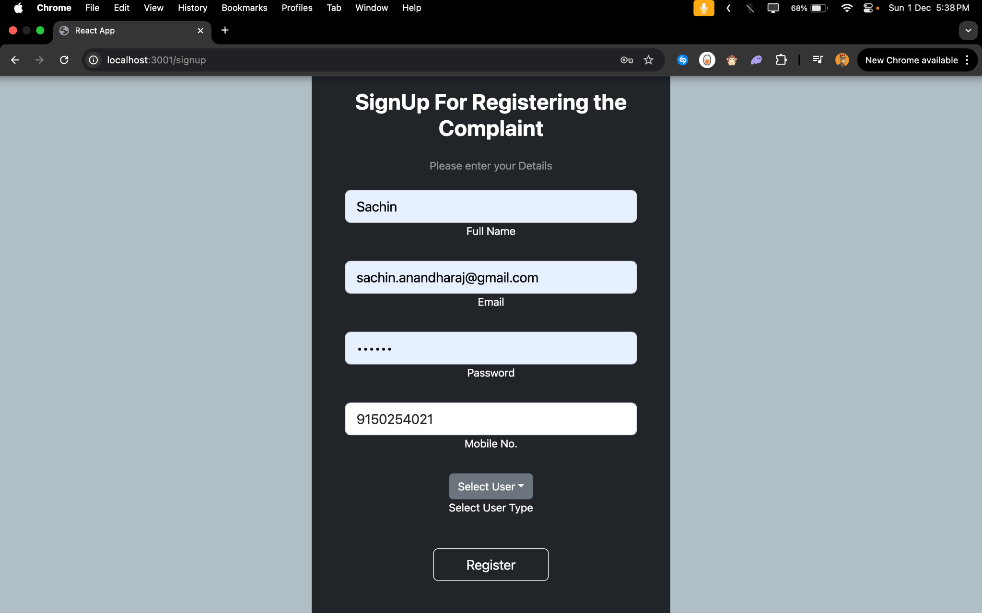

Slide 8
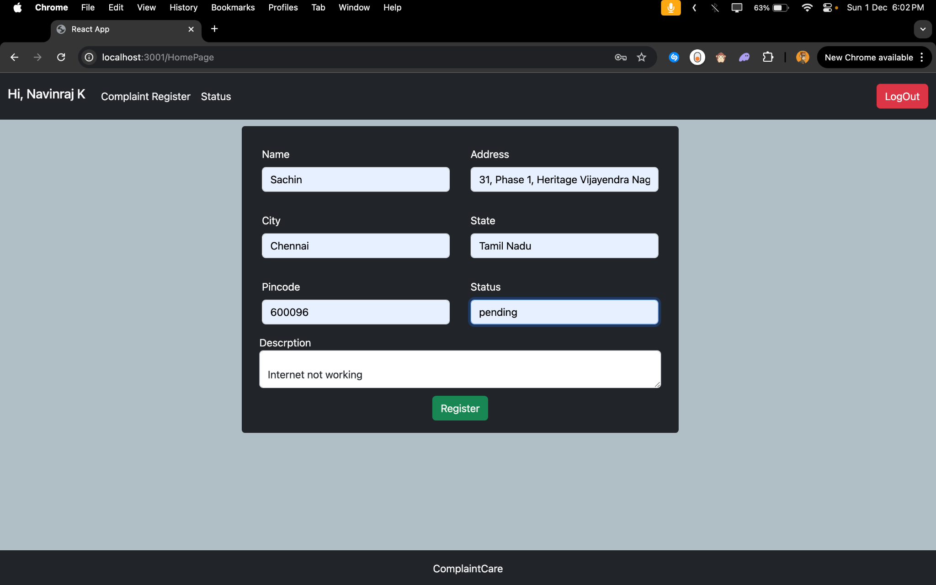

Slide 9
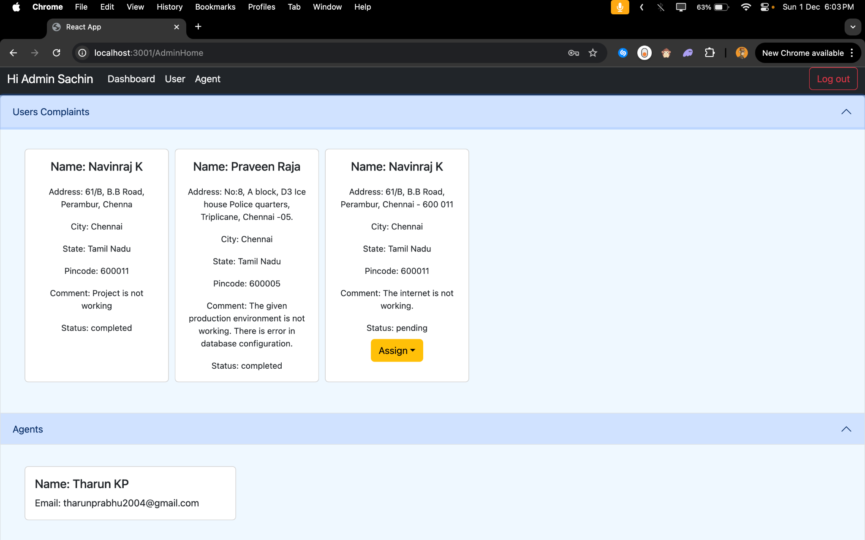

Slide 10
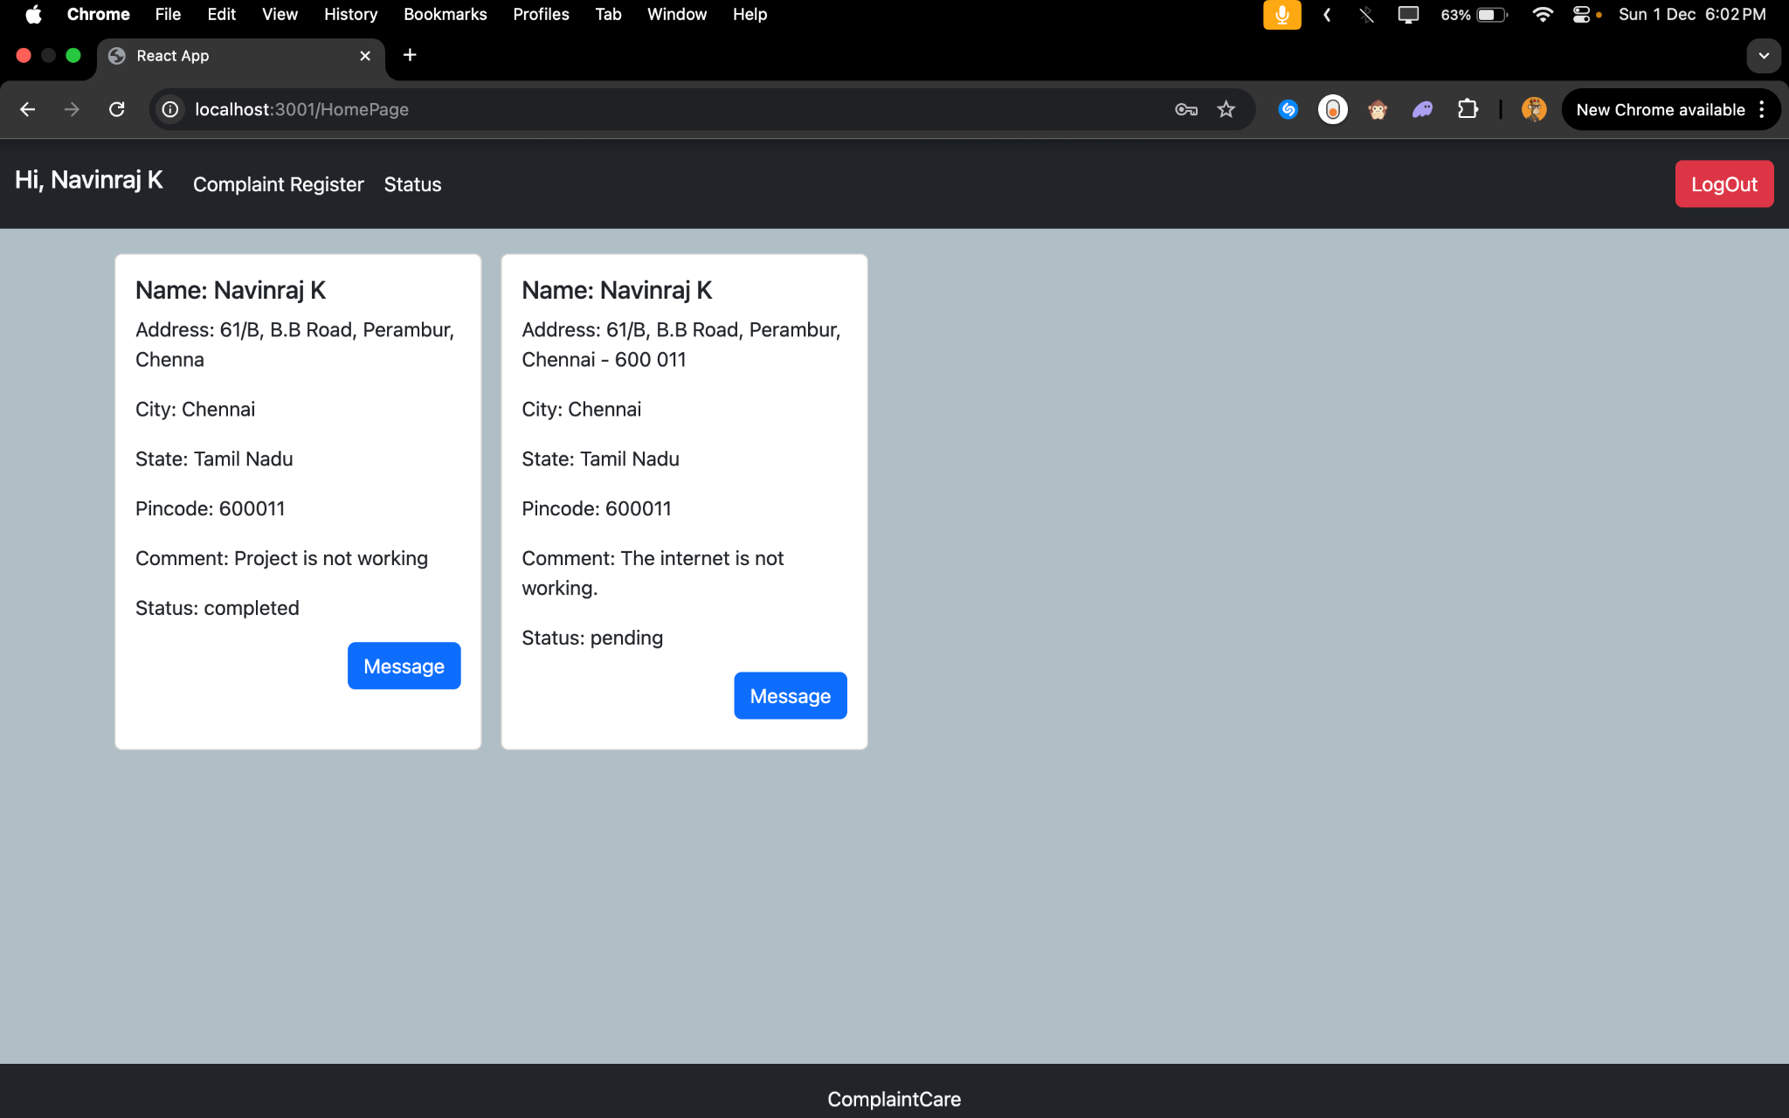

Slide 11
Testing Strategies
Unit Testing: Each feature, like complaint submission,
was tested independently.
Integration Testing: Ensured APIs and modules work
together seamlessly.
End-to-End Testing: Validated the complete workflow from
complaint creation to resolution.
Tools : Jest and Postman.
Performance Testing: Analyzes system behavior under high traffic.

Slide 12
Challenges
Real-Time Updates: Implemented Socket.IO for instant status notifications.
Data Security: Used JWT (JSON Web Tokens) for secure user authentication.
Scalability: Optimized MongoDB schema for efficient data handling.

Slide 13
Solutions
Real-Time Updates: Implemented Socket.IO for instant status notifications.
Data Security: Used JWT (JSON Web Tokens) for secure user
authentication.
Scalability: Optimized MongoDB schema for efficient data
handling.

Slide 14
Future Enhancements
AI-based priority sorting for complaints.
Advanced analytics for trend identification.
Mobile app version for accessibility.
Multilingual support to cater to diverse user bases.

Slide 15
Results and Conclusion
Results:
Reduced resolution time by automating complaint processes.
Enhanced user satisfaction with transparent tracking and updates..
Conclusion:
The project successfully addresses inefficiencies in complaint
management through a scalable and user-friendly
MERN-based solution.
.

Slide 16


